Slide 1
MA3077 (DLI) Operational Research Lecture 18 – The M/M/1 queueing system
Dr Marco Fasondini

Slide 2
Recapitulation and lecture outline
Summary: so far we have learnt:
about abstract models for queueing systems,
about Little’s formulae,
about the exponential distribution and its main properties.
In this lecture: The M/M/1 queueing system (following not-so-closely Ch. 17.6 of the book by Hillier and Lieberman).

Slide 3
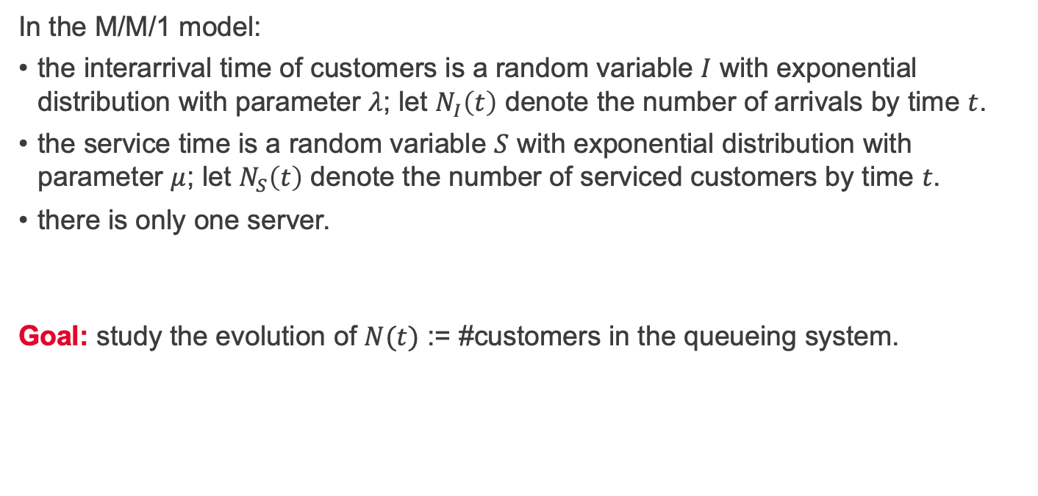
The M/M/1 model
In the M/M/1 model:
the interarrival time of customers is a random variable $I$ with exponential distribution with parameter $λ$; let $N_{I}\left(t\right)$ denote the number of arrivals by time $t$.
the service time is a random variable $S$ with exponential distribution with parameter $μ$; let $N_{S}\left(t\right)$ denote the number of serviced customers by time $t$.
there is only one server.
Goal: study the evolution of $N(t)$ := #customers in the queueing system.

Slide 4
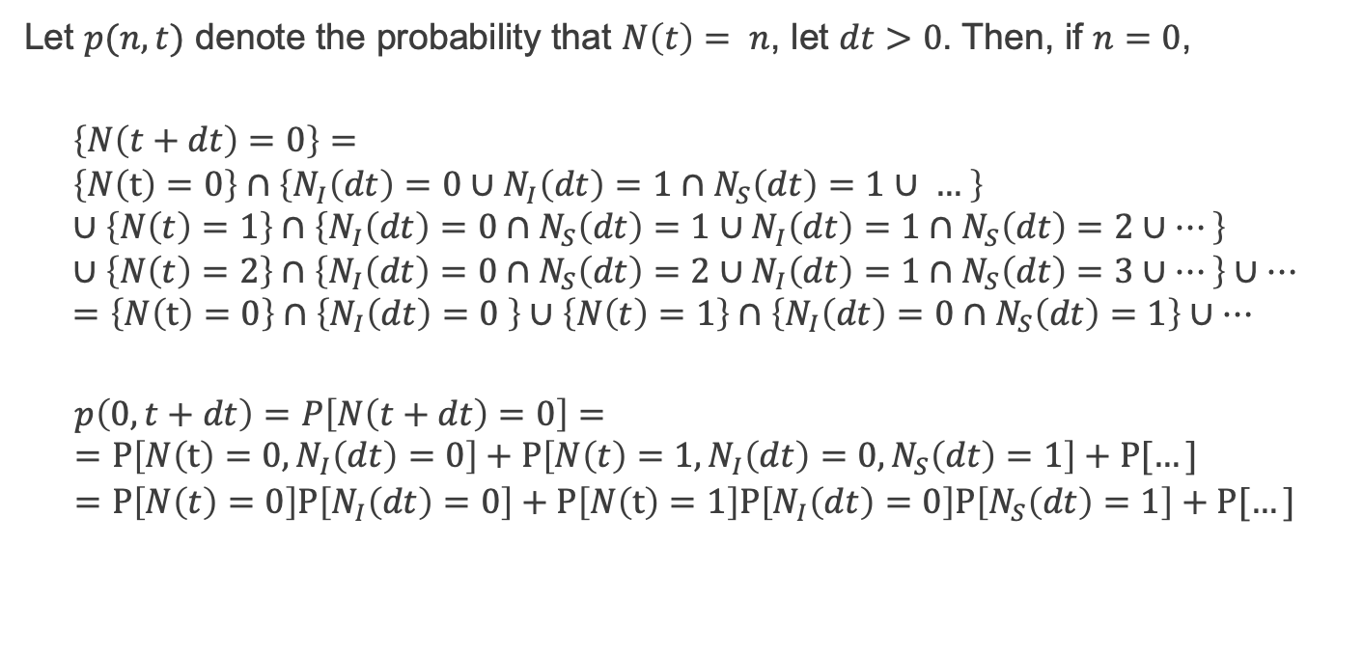
The M/M/1 model - $p\left(0, t+dt\right)$
Let $p(n,t)$ denote the probability that $N\left(t\right)= n$, let $dt>0$. Then, if $n=0$,
$$\left\{N\left(t+dt\right)=0\right\}= \\ \left\{N\left(t\right)=0\right\}∩\left\{N_{I}\left(dt\right)=0∪N_{I}\left(dt\right)=1∩N_{S}\left(dt\right)=1∪ … \right\} \\ ∪\left\{N\left(t\right)=1\right\}∩\left\{N_{I}\left(dt\right)=0∩N_{S}\left(dt\right)=1∪N_{I}\left(dt\right)=1∩N_{S}\left(dt\right)=2∪…\right\} \\ ∪\left\{N\left(t\right)=2\right\}∩\left\{N_{I}\left(dt\right)=0∩N_{S}\left(dt\right)=2∪N_{I}\left(dt\right)=1∩N_{S}\left(dt\right)=3∪…\right\}∪… \\ =\left\{N\left(t\right)=0\right\}∩\left\{N_{I}\left(dt\right)=0 \right\}∪\left\{N\left(t\right)=1\right\}∩\left\{N_{I}\left(dt\right)=0∩N_{S}\left(dt\right)=1\right\}∪…$$
$$p\left(0, t+dt\right)=P\left[N\left(t+dt\right)=0\right]= \\ =P\left[N\left(t\right)=0,N_{I}\left(dt\right)=0\right]+P\left[N\left(t\right)=1,N_{I}\left(dt\right)=0,N_{S}\left(dt\right)=1\right]+P[…] \\ =P\left[N\left(t\right)=0\right]P\left[N_{I}\left(dt\right)=0\right]+P\left[N\left(t\right)=1\right]P\left[N_{I}\left(dt\right)=0\right]P\left[N_{S}\left(dt\right)=1\right]+P[…]$$

Slide 5
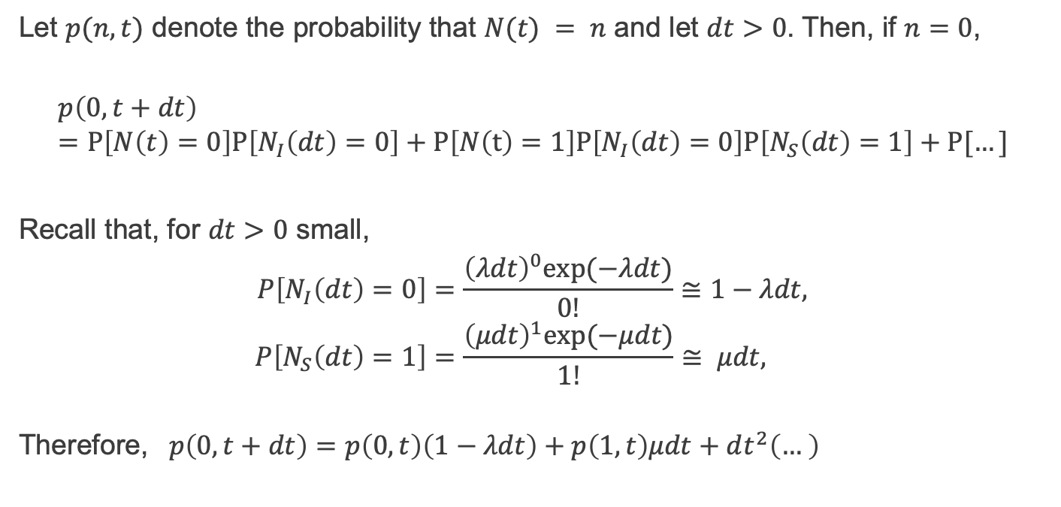
The M/M/1 model - $p\left(0, t+dt\right)$
Let $p(n,t)$ denote the probability that $N(t) = n$ and let $dt>0$. Then, if $n=0$,
$$p\left(0, t+dt\right) \\ =P\left[N\left(t\right)=0\right]P\left[N_{I}\left(dt\right)=0\right]+P\left[N\left(t\right)=1\right]P\left[N_{I}\left(dt\right)=0\right]P\left[N_{S}\left(dt\right)=1\right]+P[…]$$
Recall that, for $dt>0$ small,
$$P\left[N_{I}\left(dt\right)=0\right]=\frac{{\left(λdt\right)}^{0}exp⁡(−λdt)}{0!}≅1−λdt, \\ P\left[N_{S}\left(dt\right)=1\right]=\frac{{\left(μdt\right)}^{1}exp⁡(−μdt)}{1!}≅ μdt,$$
Therefore, $p\left(0, t+dt\right)=p\left(0,t\right)\left(1−λdt\right)+p\left(1,t\right)μdt+dt^{2}\left(… \right)$

Slide 6
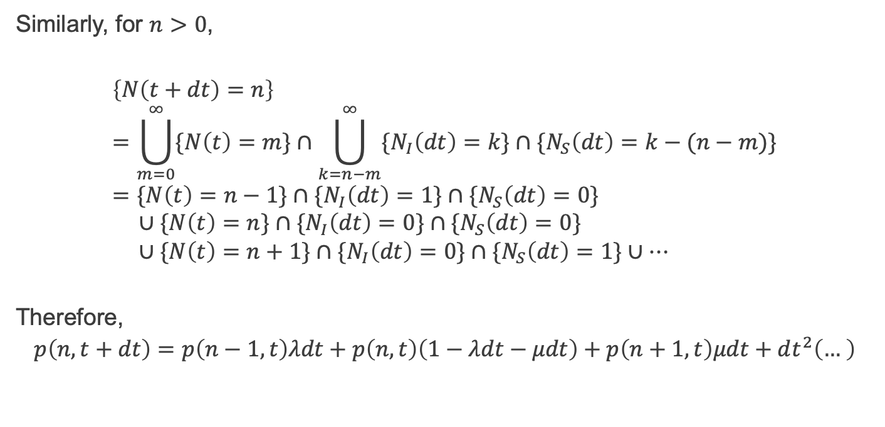
The M/M/1 model - $p\left(n, t+dt\right)$
Similarly, for $n>0$,
$$\left\{N\left(t+dt\right)=n\right\} \\ =\bigcup_{m=0}^{∞}{\{N\left(t\right)=m\}}∩\bigcup_{k=n−m}^{∞}{{\{N}_{I}\left(dt\right)=k\}∩\{N_{S}\left(dt\right)=k−(n−m)\}} \\ =\{N\left(t\right)=n−1\}∩{\{N}_{I}\left(dt\right)=1\}∩\{N_{S}\left(dt\right)=0\} \\ ∪\{N\left(t\right)=n\}∩{\{N}_{I}\left(dt\right)=0\}∩\{N_{S}\left(dt\right)=0\} \\ ∪\{N\left(t\right)=n+1\}∩{\{N}_{I}\left(dt\right)=0\}∩\{N_{S}\left(dt\right)=1\}∪…$$
Therefore,
$$p\left(n, t+dt\right)=p\left(n−1,t\right)λdt+p\left(n,t\right)\left(1−λdt−μdt\right)+p\left(n+1,t\right)μdt+dt^{2}\left(… \right)$$

Slide 7
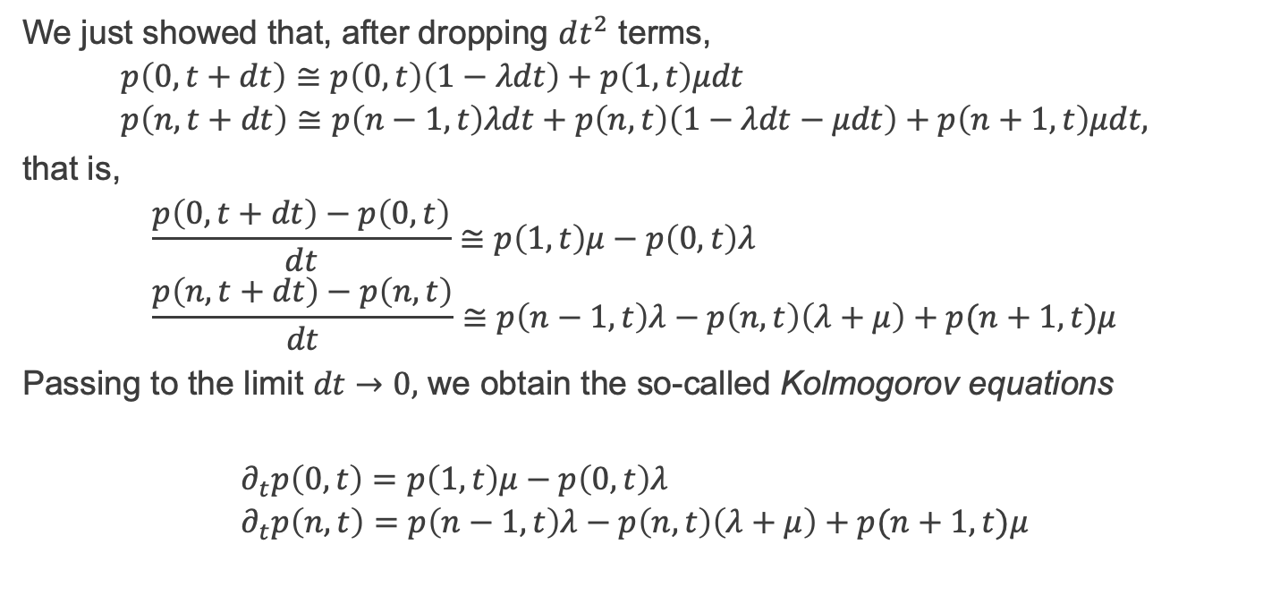
The M/M/1 model – Kolmogorov equations
We just showed that, after dropping $dt^{2}$ terms,
$$p\left(0, t+dt\right)≅p\left(0,t\right)\left(1−λdt\right)+p\left(1,t\right)μdt \\ p\left(n, t+dt\right)≅p\left(n−1,t\right)λdt+p\left(n,t\right)\left(1−λdt−μdt\right)+p\left(n+1,t\right)μdt,$$
that is,
$$\frac{p\left(0, t+dt\right)−p\left(0,t\right)}{dt}≅p\left(1,t\right)μ−p\left(0,t\right)λ \\ \frac{p\left(n, t+dt\right)−p\left(n,t\right)}{dt}≅p\left(n−1,t\right)λ−p\left(n,t\right)\left(λ+μ\right)+p(n+1,t)μ$$
Passing to the limit $dt→0,$ we obtain the so-called Kolmogorov equations
$$∂_{t}p\left(0,t\right)=p\left(1,t\right)μ−p\left(0,t\right)λ \\ ∂_{t}p\left(n,t\right)=p\left(n−1,t\right)λ−p\left(n,t\right)\left(λ+μ\right)+p(n+1,t)μ$$

Slide 8
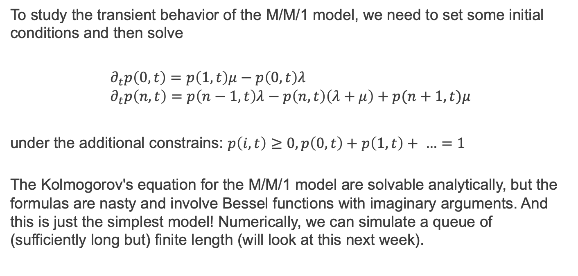
The M/M/1 model – transient behaviour
To study the transient behavior of the M/M/1 model, we need to set some initial conditions and then solve
$$∂_{t}p\left(0,t\right)=p\left(1,t\right)μ−p\left(0,t\right)λ \\ ∂_{t}p\left(n,t\right)=p\left(n−1,t\right)λ−p\left(n,t\right)\left(λ+μ\right)+p(n+1,t)μ$$
under the additional constrains: $p\left(i,t\right)≥0, p\left(0,t\right)+p\left(1,t\right)+ …=1$
The Kolmogorov's equation for the M/M/1 model are solvable analytically, but the formulas are nasty and involve Bessel functions with imaginary arguments. And this is just the simplest model! Numerically, we can simulate a queue of (sufficiently long but) finite length (will look at this next week).

Slide 9
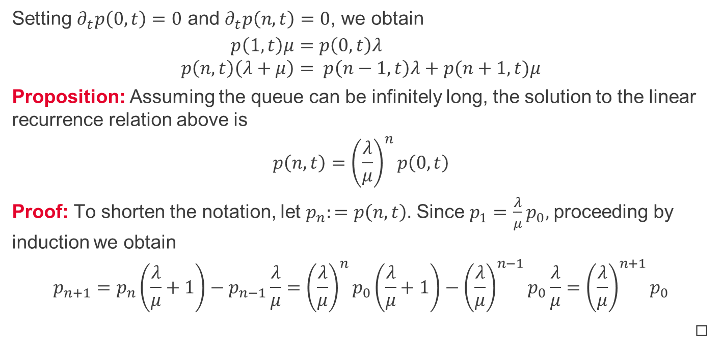
M/M/1 model – steady states
Setting $∂_{t}p\left(0,t\right)=0$ and $∂_{t}p\left(n,t\right)=0$, we obtain
$$p\left(1,t\right)μ=p\left(0,t\right)λ \\ p\left(n,t\right)\left(λ+μ\right)= p\left(n−1,t\right)λ+p(n+1,t)μ$$
Proposition: Assuming the queue can be infinitely long, the solution to the linear recurrence relation above is
$$p\left(n,t\right)={\left(\frac{λ}{μ}\right)}^{n}p\left(0,t\right)$$
Proof: To shorten the notation, let $p_{n}:=p\left(n,t\right).$ Since $p_{1}=$ $\frac{λ}{μ}p_{0},$ proceeding by induction we obtain
$$p_{n+1}=p_{n}\left(\frac{λ}{μ}+1\right)−p_{n−1}\frac{λ}{μ}={\left(\frac{λ}{μ}\right)}^{n}p_{0}\left(\frac{λ}{μ}+1\right)−{\left(\frac{λ}{μ}\right)}^{n−1}p_{0}\frac{λ}{μ}={\left(\frac{λ}{μ}\right)}^{n+1}p_{0}$$
◻︎

Slide 10
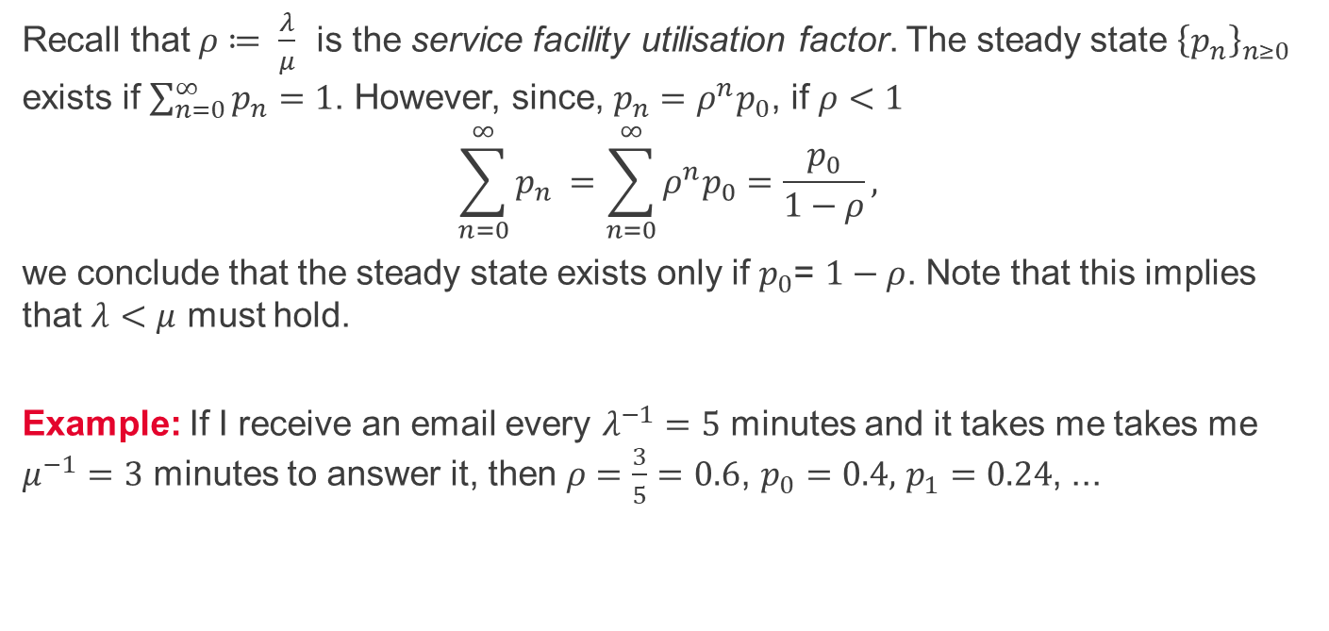
M/M/1 model – existence of steady states
Recall that $ρ≔ \frac{λ}{μ}$ is the service facility utilisation factor. The steady state ${\left\{p_{n}\right\}}_{n≥0}$ exists if $\sum_{n=0}^{∞}{p_{n}=1}$. However, since, $p_{n}=ρ^{n}p_{0}$, if $ρ<1$
$$\sum_{n=0}^{∞}{p_{n} }=\sum_{n=0}^{∞}{ρ^{n}p_{0}}=\frac{p_{0}}{1−ρ},$$
we conclude that the steady state exists only if $p_{0}$= $1−ρ$. Note that this implies that $λ<μ$ must hold.
Example: If I receive an email every $λ^{−1}=5$ minutes and it takes me takes me $μ^{−1}=3$ minutes to answer it, then $ρ=\frac{3}{5}=0.6$, $p_{0}=0.4,$ $p_{1}=0.24$, ...

Slide 11
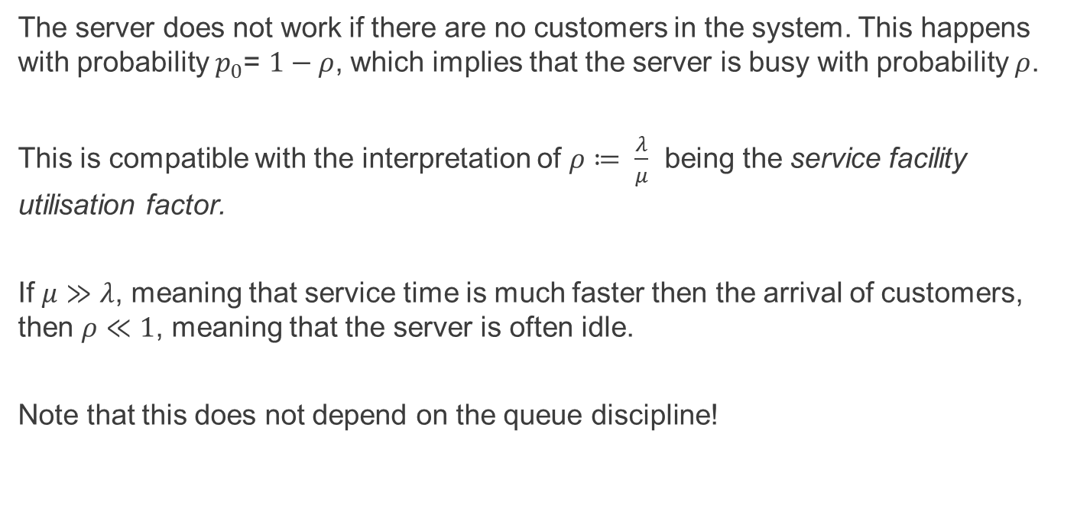
M/M/1 model – server idle time
The server does not work if there are no customers in the system. This happens with probability $p_{0}$= $1−ρ$, which implies that the server is busy with probability $ρ$.
This is compatible with the interpretation of $ρ≔ \frac{λ}{μ}$ being the service facility utilisation factor.
If $μ≫λ$, meaning that service time is much faster then the arrival of customers, then $ρ≪1$, meaning that the server is often idle.
Note that this does not depend on the queue discipline!

Slide 12
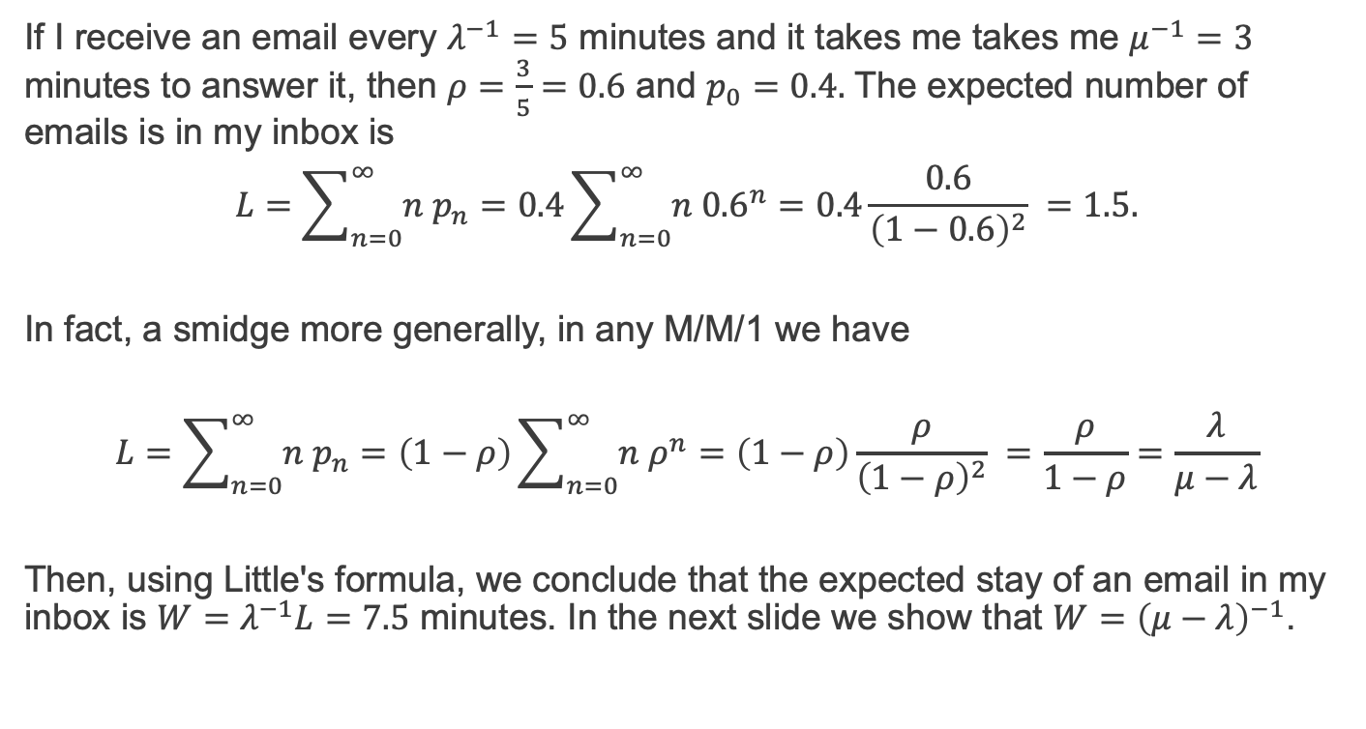
M/M/1 model – example
If I receive an email every $λ^{−1}=5$ minutes and it takes me takes me $μ^{−1}=3$ minutes to answer it, then $ρ=\frac{3}{5}=0.6$ and $p_{0}=0.4.$ The expected number of emails is in my inbox is
$$L=\sum_{n=0}^{∞}{n p_{n}}=0.4\sum_{n=0}^{∞}{n {0.6}^{n}}=0.4\frac{0.6}{{\left(1−0.6\right)}^{2}} =1.5.$$
In fact, a smidge more generally, in any M/M/1 we have
$$L=\sum_{n=0}^{∞}{n p_{n}}=\left(1−ρ\right)\sum_{n=0}^{∞}{n ρ^{n}}=\left(1−ρ\right)\frac{ρ}{{\left(1−ρ\right)}^{2}} =\frac{ρ}{1−ρ}=\frac{λ}{μ−λ}$$
Then, using Little's formula, we conclude that the expected stay of an email in my inbox is $W=$ $λ^{−1}L=7.5$ minutes. In the next slide we show that ${W=\left(μ−λ\right)}^{−1}$.

Slide 13
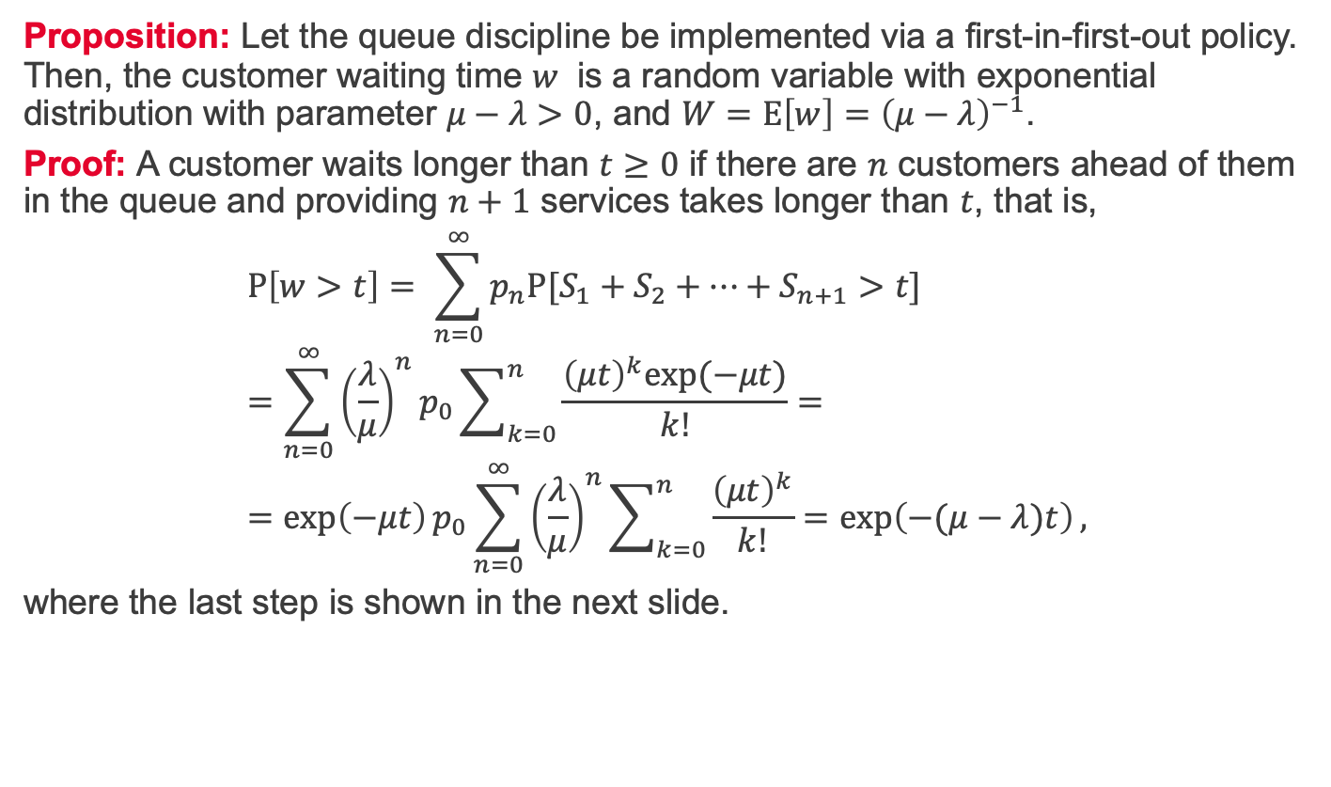
M/M/1 model – Waiting Time Distribution 1/2
Proposition: Let the queue discipline be implemented via a first-in-first-out policy. Then, the customer waiting time $w$ is a random variable with exponential distribution with parameter $μ−λ>0$, and $W=E\left[w\right]={\left(μ−λ\right)}^{−1}$.
Proof: A customer waits longer than $t≥0$ if there are $n$ customers ahead of them in the queue and providing $n+1$ services takes longer than $t$, that is,
$$P\left[w>t\right]= \sum_{n=0}^{∞}{p_{n}P[S_{1}+S_{2}+…+S_{n+1}>t]} \\ =\sum_{n=0}^{∞}{{\left(\frac{λ}{μ}\right)}^{n}p_{0}\sum_{k=0}^{n}{\frac{{\left(μt\right)}^{k}exp⁡(−μt)}{k!}}}= \\ =\exp\left(−μt\right)p_{0}\sum_{n=0}^{∞}{{\left(\frac{λ}{μ}\right)}^{n}\sum_{k=0}^{n}{\frac{{\left(μt\right)}^{k}}{k!}}}=\exp\left(−(μ−λ)t\right),$$
where the last step is shown in the next slide.

Slide 14
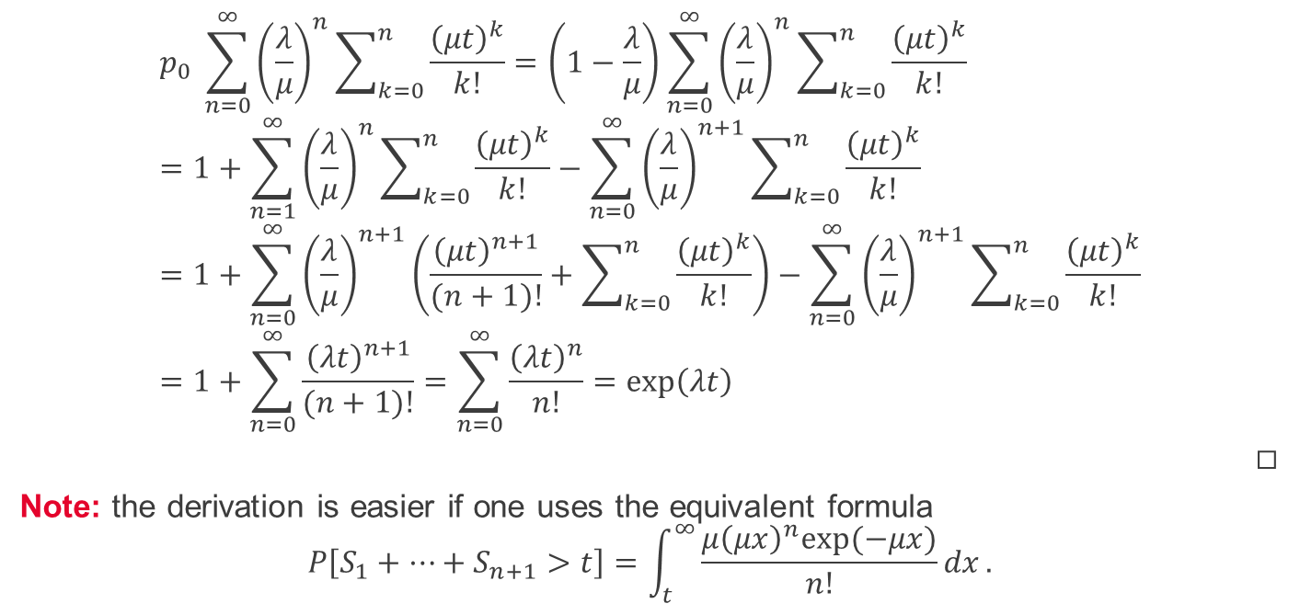
M/M/1 model – Waiting Time Distribution 2/2
$$p_{0} \sum_{n=0}^{∞}{{\left(\frac{λ}{μ}\right)}^{n}\sum_{k=0}^{n}{\frac{{\left(μt\right)}^{k}}{k!}}}=\left(1−\frac{λ}{μ}\right)\sum_{n=0}^{∞}{{\left(\frac{λ}{μ}\right)}^{n}\sum_{k=0}^{n}{\frac{{\left(μt\right)}^{k}}{k!}}} \\ =1+\sum_{n=1}^{∞}{{\left(\frac{λ}{μ}\right)}^{n}\sum_{k=0}^{n}{\frac{{\left(μt\right)}^{k}}{k!}}−\sum_{n=0}^{∞}{{\left(\frac{λ}{μ}\right)}^{n+1}\sum_{k=0}^{n}{\frac{{\left(μt\right)}^{k}}{k!}}}} \\ =1+\sum_{n=0}^{∞}{{\left(\frac{λ}{μ}\right)}^{n+1}\left(\frac{{\left(μt\right)}^{n+1}}{(n+1)!}+\sum_{k=0}^{n}{\frac{{\left(μt\right)}^{k}}{k!}}\right)−\sum_{n=0}^{∞}{{\left(\frac{λ}{μ}\right)}^{n+1}\sum_{k=0}^{n}{\frac{{\left(μt\right)}^{k}}{k!}}}} \\ =1+\sum_{n=0}^{∞}{\frac{{\left(λt\right)}^{n+1}}{(n+1)!}}=\sum_{n=0}^{∞}{\frac{{\left(λt\right)}^{n}}{n!}}=\exp\left(λt\right)$$ ◻︎
Note: the derivation is easier if one uses the equivalent formula $$P\left[S_{1}+…+S_{n+1}>t\right]=\int_{t}^{∞}{\frac{{μ\left(μx\right)}^{n}exp⁡(−μx)}{n!}dx}.$$

Slide 15
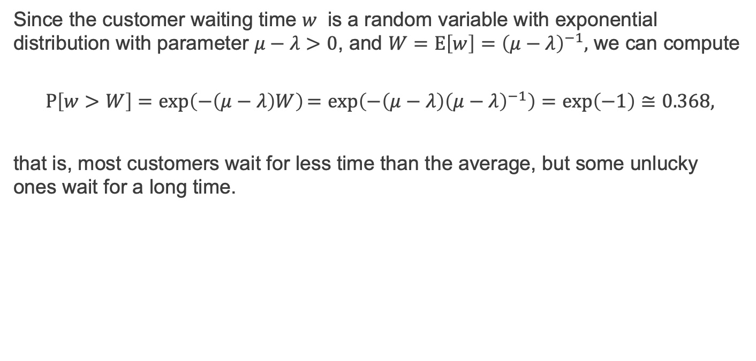
M/M/1 model – average waiting time
Since the customer waiting time $w$ is a random variable with exponential distribution with parameter $μ−λ>0$, and $W=E\left[w\right]={\left(μ−λ\right)}^{−1},$ we can compute
$$P\left[w>W\right]=\exp\left(−\left(μ−λ\right)W\right)=exp\left(−\left(μ−λ\right){\left(μ−λ\right)}^{−1}\right)=\exp\left(−1\right)≅0.368,$$
that is, most customers wait for less time than the average, but some unlucky ones wait for a long time.

Slide 16
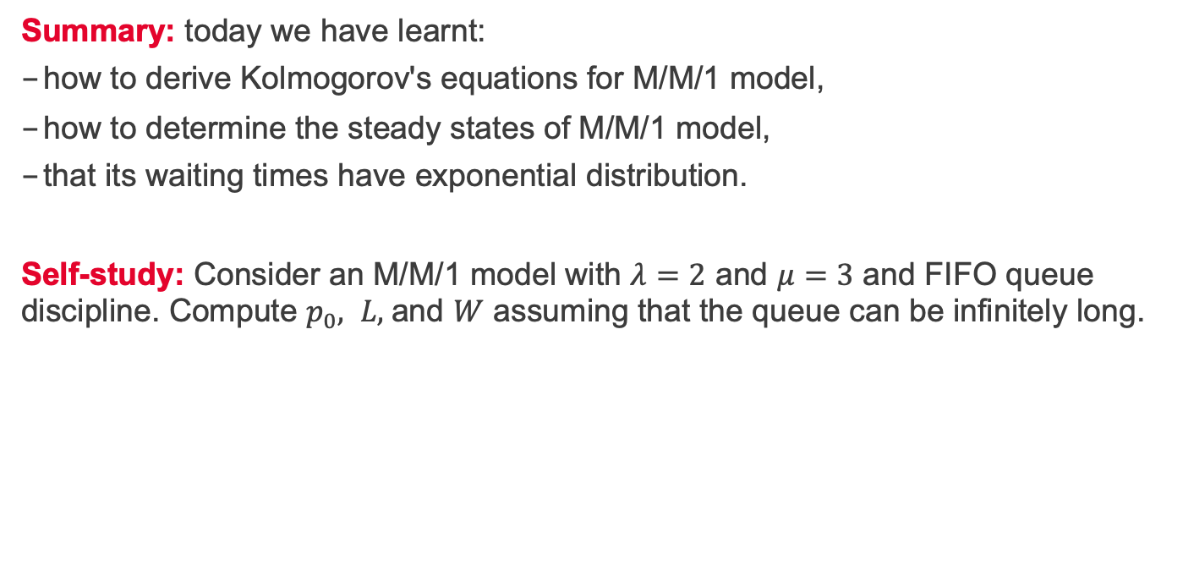
Summary and self-study
Summary: today we have learnt:
how to derive Kolmogorov's equations for M/M/1 model,
how to determine the steady states of M/M/1 model,
that its waiting times have exponential distribution.
Self-study: Consider an M/M/1 model with $λ=2$ and $μ=3$ and FIFO queue discipline. Compute $p_{0}, L,$and $W$ assuming that the queue can be infinitely long.

